Slide 1
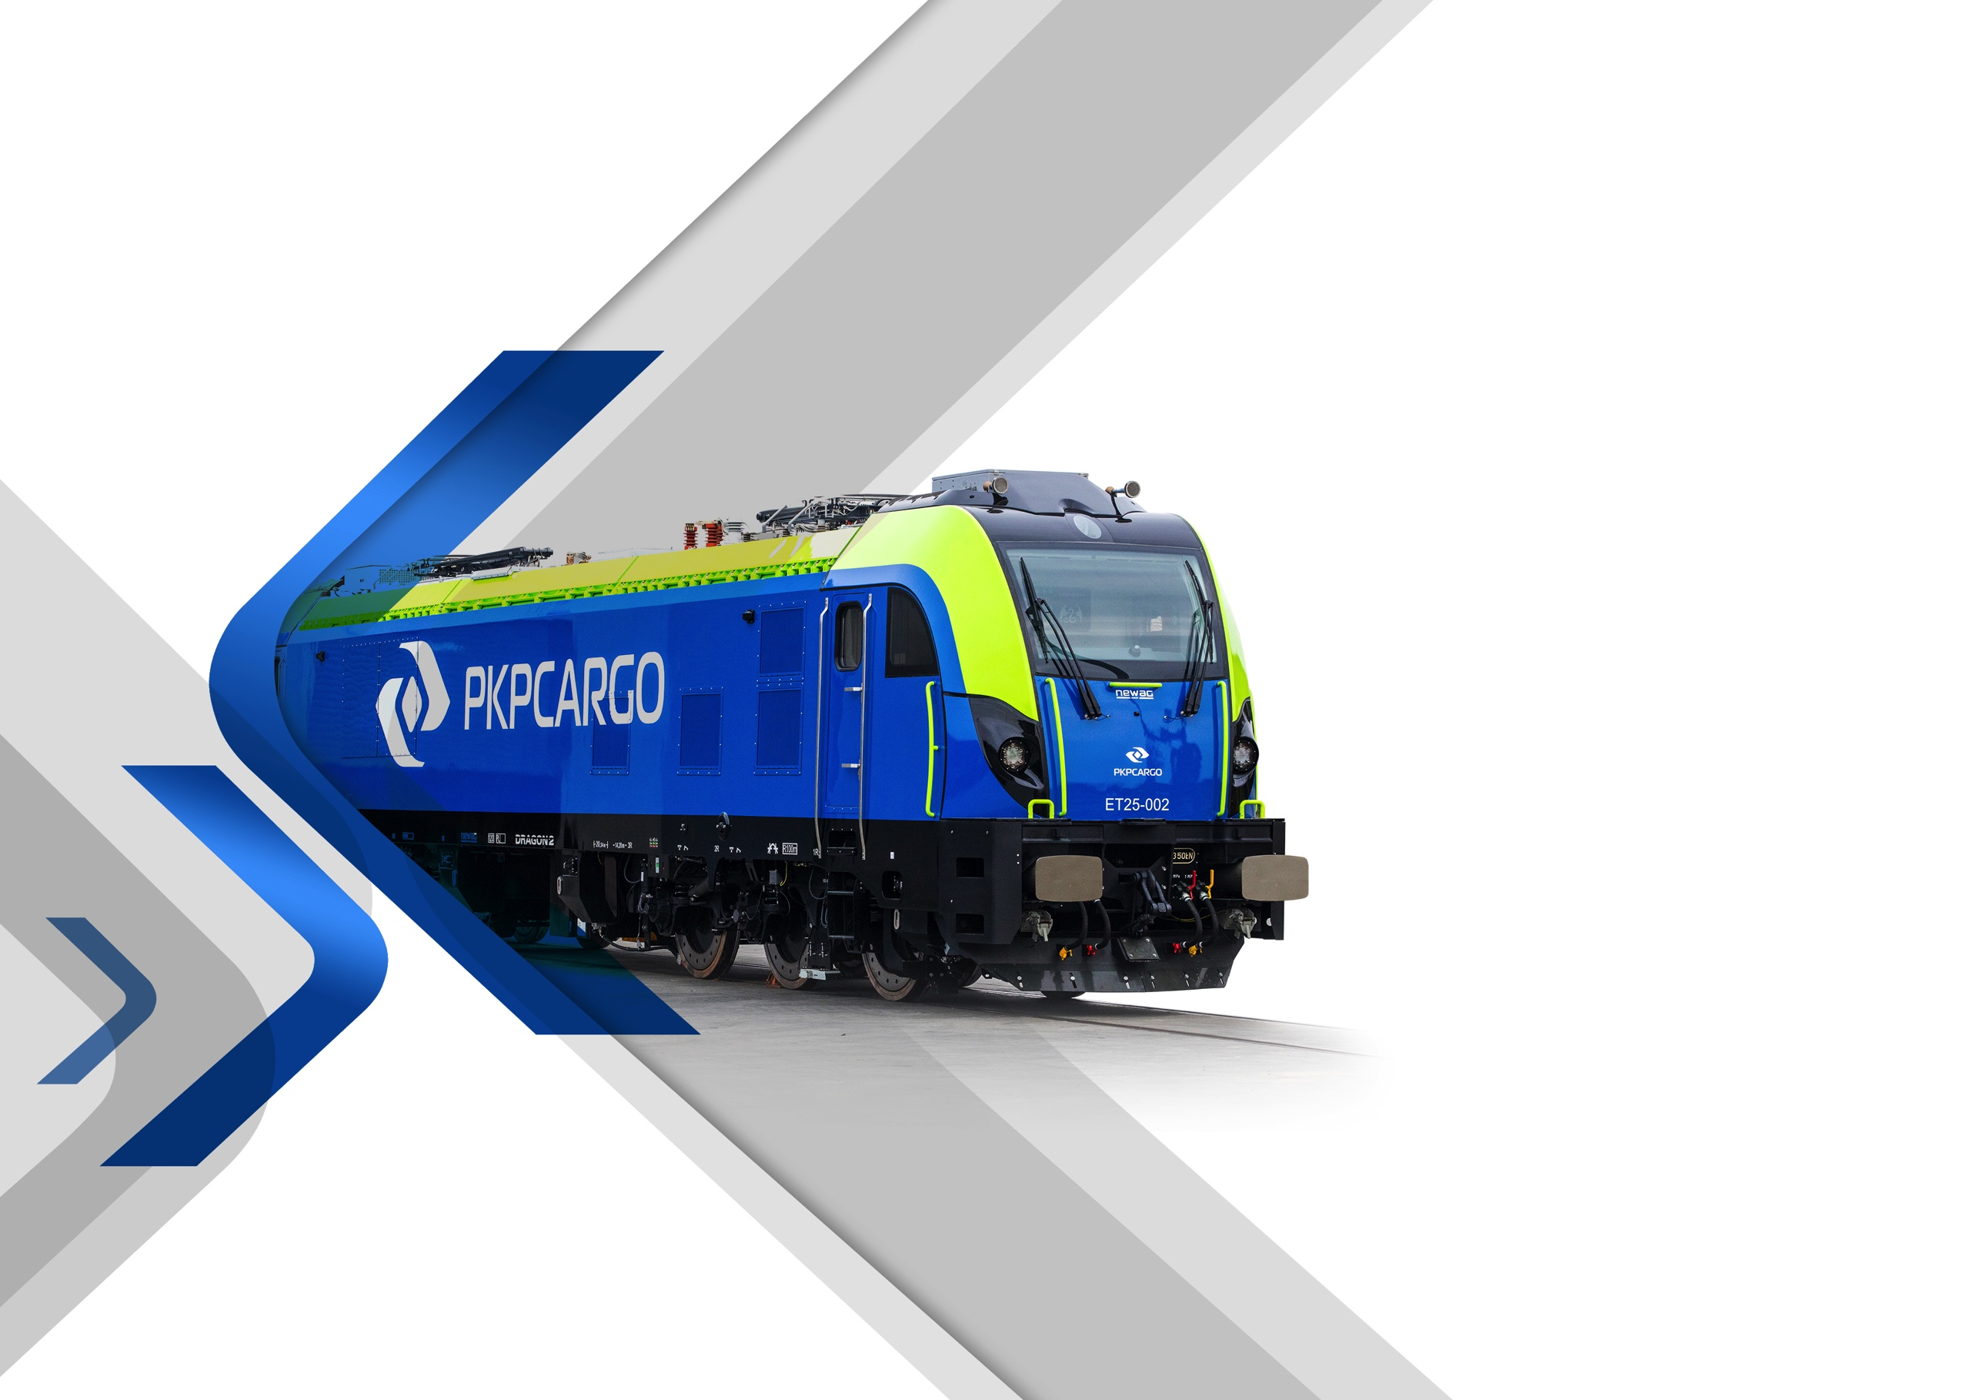
PKP CARGO GROUP
2021
Notes:
Usunąć Lidera / ew. Zamienić zdjęcie na inne

Slide 2
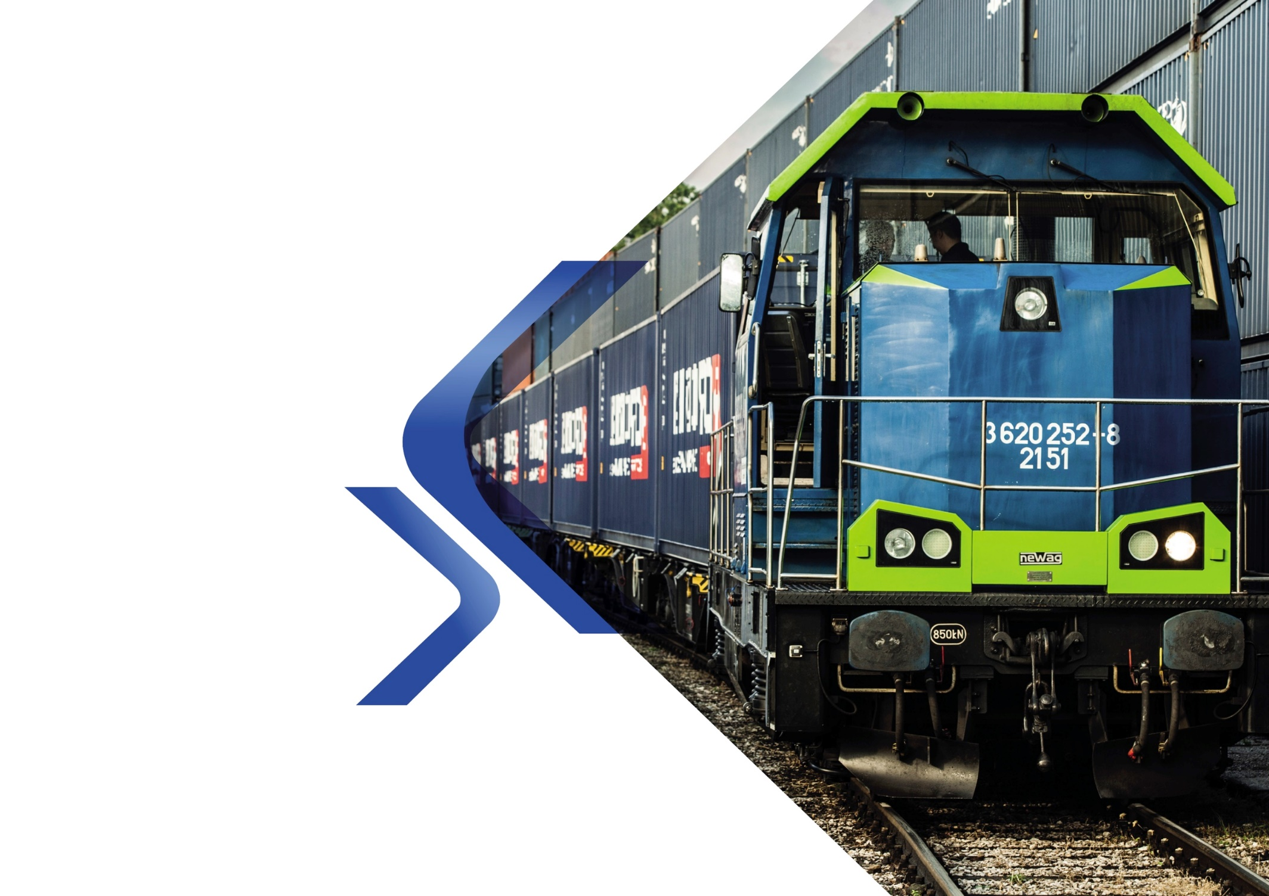


2021
Financial and operating results

Slide 3

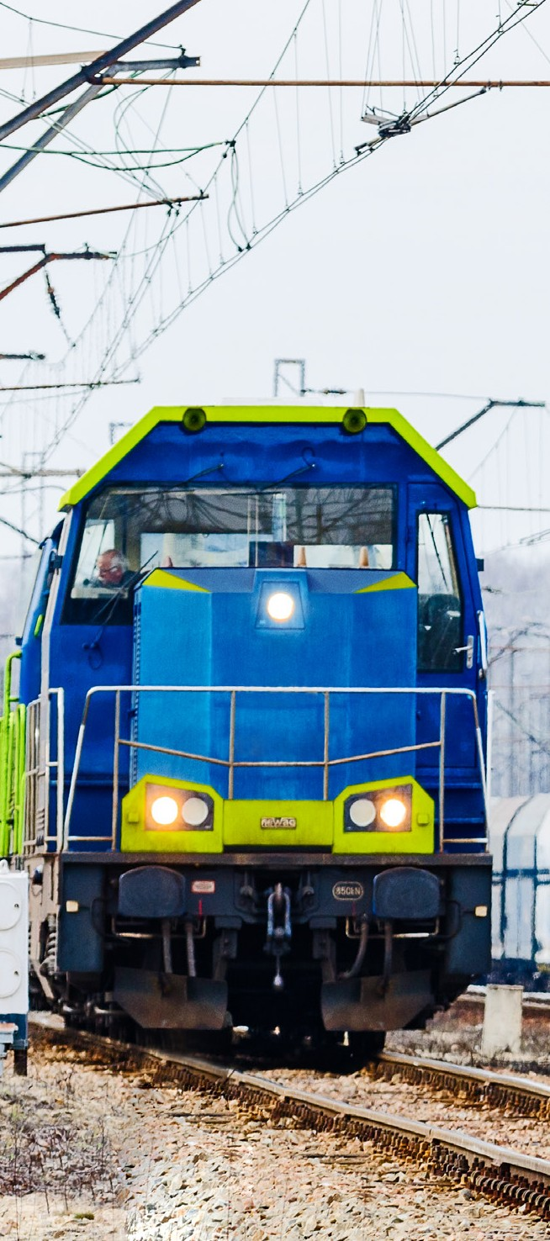


Results of the PKP CARGO Group in 2021
Financial data
for 12M 2021
Operational data
for 12M 2021
PLN 4,266.5 million revenues from contracts
with customers
PLN 513.2 million
EBITDA
PLN -208.8 million
EBIT
25,590 million tkm
freight turnover
101.6 million tons
freight volume
1,206.5 thousand tkm
freight turnover per FTE

Slide 4




Situation in key cargo categories
Solid fuels
increase in electricity generation due to stronger demand from buyers
changes in the energy mix (increased significance of electricity produced from hard coal and decreased significance
of wind and gas-fired energy)
increase in coal production in OKD
declining share of electricity imports
Construction materials and aggregates
increased customer demand for construction stone due to the increase in the quantum of transport for the construction of road projects
stronger customer demand for repairs and modernization of railway routes
increased haul distance of aggregates, among others for the construction of S7 and the Rail Baltica rail line
increased volume of clinker and limestone transports to the Czech Republic
Intermodal transport
increased volume of transport of semi-trailers as part of operator connections to Duisburg and from Lithuania to the Netherlands
launch of an intermodal connection to Turkey in cooperation with PKP CARGO CONNECT
lower volume of transported woodchips
decline in transport services on the New Silk Road due to the reduced capacity of rail routes
Metals and ores
greater demand for steel products
increase in steel imports from within and without the EU
decrease in the volume of PKP CARGO INTERNATIONAL’s transport services due to the reduced output of Czech steelworks and the takeover of a portion of the transport market by another rail operator in the Czech Republic
decrease in the average haul caused by a shorter haul of transported metals

Slide 5
Structure of transport of key cargo categories
in 2016-2021
FREIGHT TURNOVER OF THE PKP CARGO GROUP
2016 - 2021
billion tkm
31.0
31.4
Hard coal
28.5
26.9
25.6
Aggregates
and construction materials
23.6
Intermodal transport
Metals and ores
2016
2017
2018
2019
2020
2021
Other cargo
To facilitate the reading of this presentation, some figures have been rounded off, which may cause negligible deviations in the presented data.

Slide 6
Structure of transport of key cargo categories
in 2016-2021
PKP CARGO GROUP’S FREIGHT VOLUME
2016 - 2021
million tons
119.1
121.9
Hard coal
111.5
108.6
101.6
Aggregates
and construction materials
51.7
93.6
Intermodal transport
6.5
Metals and ores
6.2
2016
2017
2018
2019
2020
2021
Other cargo
To facilitate the reading of this presentation, some figures have been rounded off, which may cause negligible deviations in the presented data.

Slide 7
Revenues of the PKP CARGO Group from contracts with customers
in 2016-2021 (PLN billion)
In 2021, revenues were affected
chiefly by:
increased demand for transport services associated with improved business conditions
increased revenues from contracts with customers:
  from transportation and forwarding services,
  from siding and traction services
  from sales of materials
increase in freight volume and freight turnover by 8.6% and 8.2%, respectively
+5%
4.69
5.18
4.78
4.37
4.08
4.27
2016
2017
2018
2019
2020
2021
To facilitate the reading of this presentation, some figures have been rounded off, which may cause negligible deviations in the presented data.

Slide 8
Unit costs and revenues of the PKP CARGO Group
UNIT REVENUES
OF THE PKP CARGO GROUP
PLN / thous. tkm
UNIT COSTS
OF THE PKP CARGO GROUP
PLN / thous. tkm
-3.3%
-5.2%
  185
Employee benefits
  172
  167
  176
Energy and
traction fuel
Freight and
forwarding revenues
Access
to infrastructure
Other revenues from contracts with customers¹
Depreciation, amortization and impairment losses
Transport services and
other services
Other expenses
2020
2021
2020
2021
Label
¹ Revenues from contracts with customers, excluding revenues on rail transportation and freight forwarding services

Slide 9
Structure and level of employment in the PKP CARGO Group
EMPLOYEES OF THE PKP CARGO GROUP
-6%
21,766
20,562
4,808
15,754
White-collar
jobs
Blue-collar
jobs
31 Dec 2020
31 Dec 2021
As at 31 December 2021
Group companies
PKP CARGO S.A.

Slide 10
EBITDA in 2016-2021
Key EBITDA drivers in 2021:
increased scale of business with a simultaneous decline in unit freight rates (more intense competitive struggle in the transport market as a consequence of the COVID-19 pandemic)
increase in variable costs (consumption of electricity and traction fuel and infrastructure access services) with simultaneously higher unit costs of traction fuel and energy
decrease of employee benefits in connection with, among other factors, a decrease in the average headcount level by more than 1,000 people
impact of non-recurring events – an effect of a high statistical base as a result of the receipt in 2020 of funding under the anti-crisis shield in the amount of PLN 115.2 million (decrease in other operating revenues on a yoy basis)
EBITDA OF THE PKP CARGO GROUP
2016-2021
PLN million
907
860
700
490
580
513
2016
2017
2018
2019
2020
2021
To facilitate the reading of this presentation, some figures have been rounded off, which may cause negligible deviations in the presented data.

Slide 11
Balance sheet structure and funding sources
KEY BALANCE SHEET ITEMS
FINANCIAL RATIOS
PLN million | 31 Dec 2020 | 31 Dec 2021
Fixed capital | 6,173.3 | 5,874.4
Non-current assets | 6,397.4 | 6,458.7
Coverage ratio¹ | 0.96 | 0.91
Total debt | 4,415.6 | 4,572.8
Total debt ratio | 0.58 | 0.60
 | 2020 | 2021
ROA² | -3.0% | -3.0%
ROE³ | -7.1% | -7.4%
EBITDA margin⁴ | 13.7% | 11.9%
Calculated as the ratio of total equity and non-current liabilities to non-current assets
Calculated as the ratio of net result for the last 12 months to total assets
Calculated as the ratio of the net result for the last 12 months to equity
Calculated as the ratio of the operating result plus depreciation and amortization (EBITDA) to total operating revenue
AVAILABLE FUNDING SOURCES
As at 31 December 2021
PLN million
15
100
Cash
Pekao S.A.
570.1
255
PKO BP S.A.
BGK
100
PKO Leasing S.A.
100
To facilitate the reading of this presentation, some figures have been rounded off, which may cause negligible deviations in the presented data.

Slide 12
Appendixes

Slide 13
PKP CARGO Group’s freight turnover in 2020-2021
FREIGHT TURNOVER [million tkm] | 2021 | 2020 | Change | % Change | Share in 2021 | Share in 2020
Solid fuels, including: | 9,583 | 8,621 | 962 | 11.2% | 37% | 36%
hard coal | 7,848 | 7,112 | 736 | 10.3% | 31% | 30%
Aggregates & constr.materials | 5,131 | 4,509 | 622 | 13.8% | 20% | 19%
Metals and ores | 2,145 | 1,980 | 165 | 8.3% | 8% | 8%
Chemicals | 2,246 | 1,937 | 309 | 15.9% | 9% | 8%
Liquid fuels | 649 | 681 | -32 | -4.7% | 3% | 3%
Timber & agricultural produce | 785 | 984 | -199 | -20.2% | 3% | 4%
Intermodal transport | 4,544 | 4,290 | 254 | 5.9% | 18% | 18%
Other | 508 | 646 | -139 | -21.4% | 2% | 3%
Total | 25,590 | 23,649 | 1,941 | 8.2% | 100% | 100%
FREIGHT VOLUME [million tons] | 2021 | 2020 | Change | % Change | Share in 2021 | Share in 2020
Solid fuels, including: | 52.1 | 47.3 | 4.8 | 10.1% | 51% | 51%
hard coal | 46.2 | 42.5 | 3.7 | 8.7% | 46% | 45%
Aggregates & constr.materials | 19.8 | 17.9 | 1.9 | 10.8% | 20% | 19%
Metals and ores | 7.1 | 6.2 | 0.9 | 14.8% | 7% | 7%
Chemicals | 6.5 | 5.8 | 0.7 | 12.4% | 6% | 6%
Liquid fuels | 1.9 | 2.0 | -0.1 | -6.0% | 2% | 2%
Timber & agricultural produce | 2.4 | 2.8 | -0.4 | -13.5% | 2% | 3%
Intermodal transport | 10.0 | 9.7 | 0.3 | 2.7% | 10% | 10%
Other | 1.8 | 2.0 | -0.1 | -5.9% | 2% | 2%
Total | 101.6 | 93.6 | 8.0 | 8.6% | 100% | 100%

Slide 14
CONSOLIDATED STATEMENT OF PROFIT OR LOSS AND OTHER COMPREHENSIVE INCOME
 | 2021 | 2020
Revenues from contracts with customers | 4,266.5 | 4,075.6
Operating expenses
Consumption of electricity and traction fuel | (550.2) | (492.7)
Infrastructure access services | (530.0) | (517.3)
Transport services | (350.7) | (340.5)
Other services | (413.9) | (365.8)
Employee benefits | (1,622.0) | (1,638.1)
Other expenses | (309.1) | (264.6)
Other operating revenue (and expenses) | 22.6 | 123.6
Operating profit before depreciation and amortization (EBITDA) | 513.2 | 580.2
Depreciation, amortization and impairment allowances | (722.0) | (766.6)
Profit / (loss) on operating activities (EBIT) | (208.8) | (186.4)
Financial revenue (and expenses) | (60.3) | (82.2)
Share in the profit / (loss) of entities accounted for under the equity method | 4.7 | 1.7
Profit / (loss) before tax | (264.4) | (266.9)
Income tax | 39.1 | 42.6
NET PROFIT / (LOSS) | (225.3) | (224.3)
OTHER COMPREHENSIVE INCOME
Measurement of hedging instruments | 13.2 | (50.8)
Income tax | (2.5) | 9.7
Exchange differences from conversion of financial statements of foreign operations | 37.7 | 27.3
Total other comprehensive income subject to reclassification to profit or loss | 48.4 | (13.8)
Actuarial gains / (losses) on employee benefits | 91.0 | (50.2)
Income tax | (17.3) | 9.5
Measurement of equity instruments at fair value | - | (0.7)
Total other comprehensive income not subject to reclassification to profit or loss | 73.7 | (41.4)
Total other comprehensive income | 122.1 | (55.2)
TOTAL COMPREHENSIVE INCOME | (103.2) | (279.5)

Slide 15
CONSOLIDATED STATEMENT OF FINANCIAL POSITION - ASSETS
 | 31 December 2021 | 31 December 2020
ASSETS
Rolling stock | 4,241.6 | 4,245.0
Other property, plant and equipment | 893.4 | 875.6
Right-of-use assets | 1,030.7 | 1,008.6
Investments in entities accounted for under the equity method | 36.7 | 42.0
Trade receivables | 4.2 | 3.0
Lease receivables | 8.5 | 10.3
Other assets | 40.5 | 35.1
Deferred tax assets | 203.1 | 177.8
Total non-current assets | 6,458.7 | 6,397.4
Inventories | 164.6 | 165.8
Trade receivables | 611.7 | 585.8
Lease receivables | 0.6 | 0.7
Income tax receivables | 4.5 | 2.9
Other assets | 103.1 | 88.1
Cash and cash equivalents | 254.5 | 306.0
Total current assets | 1,139.0 | 1,149.3
Non-current assets classified as held for sale | 15.7 | 12.7
TOTAL ASSETS | 7,613.4 | 7,559.4

Slide 16
CONSOLIDATED STATEMENT OF FINANCIAL POSITION – EQUITY AND LIABILITIES
EQUITY AND LIABILITIES
Share capital | 2,239.3 | 2,239.3
Supplementary capital | 771.7 | 782.4
Other items of equity | (75.8) | (160.2)
Exchange differences from conversion of financial statements of foreign operations | 142.5 | 104.8
Retained earnings / (Accumulated losses) | (37.1) | 177.5
Total equity | 3,040.6 | 3,143.8
Debt liabilities | 2,090.3 | 2,101.8
Trade payables | 2.3 | 1.5
Investment commitments | 111.8 | 145.5
Provisions for employee benefits | 529.1 | 684.3
Other provisions | 7.0 | 5.7
Deferred tax liability | 93.3 | 90.7
Total non-current liabilities | 2,833.8 | 3,029.5
Debt liabilities | 473.9 | 478.5
Trade payables | 639.0 | 347.5
Investment commitments | 221.4 | 133.5
Provisions for employee benefits | 127.3 | 116.3
Other provisions | 23.3 | 24.1
Other liabilities | 254.1 | 286.2
Total current liabilities | 1,739.0 | 1,386.1
Total liabilities | 4,572.8 | 4,415.6
TOTAL EQUITY AND LIABILITIES | 7,613.4 | 7,559.4

Slide 17
CONSOLIDATED CASH FLOW STATEMENT
 | 2021 | 2020
Cash flows from operating activities
Profit / (loss) before tax | (264.4) | (266.9)
Adjustments
Depreciation, amortization and impairment allowances | 722.0 | 766.6
(Profit) / loss on the sale and liquidation of non-financial non-current assets | (19.2) | (8.9)
Foreign exchange (gains)/losses | 4.8 | 13.9
(Profits) / losses on interest, dividends | 50.1 | 54.4
Interest received / (paid) | 0.7 | 2.0
Income tax received / (paid) | (11.3) | 42.9
Movement in working capital | 125.1 | 12.4
Other adjustments | 92.0 | (63.3)
Net cash from operating activities | 699.8 | 553.1
Cash flows from investing activities
Expenditures on the acquisition of non-financial non-current assets | (808.5) | (719.0)
Proceeds from the sale of non-financial non-current assets | 158.4 | 60.3
Proceeds from dividends received | 2.9 | 0.4
Other proceeds / (expenditures) from investing activities | 1.6 | 3.2
Net cash from investing activities | (645.6) | (655.1)
Cash flows from financing activities
Expenditures on leases | (128.5) | (148.5)
Proceeds from drawn down loans / credit facilities | 323.9 | 285.7
Repayment of loans/ credit facilities | (348.6) | (301.2)
Interest paid on leases and loans/borrowings | (42.4) | (53.0)
Subsidies received | 93.3 | 74.7
Other expenditures concerning financing activities | (4.1) | (3.6)
Net cash from financing activities | (106.4) | (145.9)
Net increase / (decrease) in cash and cash equivalents | (52.2) | (247.9)
Cash and cash equivalents at the beginning of the reporting period | 306.0 | 550.4
Impact of FX rate movements on the cash balance in foreign currencies | 0.7 | 3.5
Cash and cash equivalents at the end of the reporting period, including: | 254.5 | 306.0
restricted cash | 60.6 | 49.1

Slide 18
Capital expenditures in the PKP CARGO Group
Item | 2021 | 2020 | 2019 | 2018 | 2017 | Change 2021-2020 | Change 2021/2020 in %
Investment construction activity | 70.5 | 50.8 | 39.5 | 48.1 | 32.1 | 19.7 | 38.8%
Purchases of locomotives | 0.4 | 33.0 | 65.3 | 43.8 | 53.0 | -32.6 | -98.8%
Modernization of locomotives | 99.4 | 132.0 | 258.5 | 147.9 | 67.0 | -32.6 | -24.7%
Purchases of wagons | 184.7 | 162.9 | 69.9 | 11.1 | 13.3 | 21.8 | 13.4%
Wagon upgrades | 0.0 | 5.6 | 2.0 | 0.0 | 1.7 | -5.6 | -100.0%
Workshop machinery and equipment | 32.2 | 12.0 | 26.6 | 26.3 | 17.6 | 20.2 | 168.5%
ICT development | 12.8 | 10.8 | 14.1 | 16.6 | 16.3 | 2.0 | 18.9%
Other | 1.5 | 2.5 | 4.8 | 1.9 | 2.4 | -1.0 | -38.2%
Components in overhaul, including: | 441.3 | 276.5 | 632.0 | 598.4 | 358.6 | 164.8 | 59.6%
Repairs and periodic inspections of locomotives | 115.9 | 73.7 | 167.1 | 171.7 | 77.3 | 42.2 | 57.3%
Repairs and periodic inspections of wagons | 325.4 | 202.8 | 464.9 | 426.7 | 281.3 | 122.5 | 60.4%
Right-of-use assets* | 65.5 | 68.4 | 237.6 | - | - | -2.9 | -4.3%
Total | 908.3 | 754.5 | 1,350.3 | 894.1 | 562.0 | 153.8 | 20.4%

